Slide 1
CS462: Senior Software Engineering Project
A Web-Based Tool for Task-Delineated, AI-Assisted Assignments
Group 28:
Oliver Zhou, Ethan Lu, Trent Matsumura, Sai Anand, Collin Kimball

Slide 2
Project Introduction
This project is a website that acts as a more extensively featured Learning Management System, similar to Canvas.
Key Features:
Task-delineation: Meaning divided tasks which enables complex structures for delivering assignments and tasks to students, allowing “stories.”
AI-integration: Implements AI tools to help instructors develop class content and evaluate student performance, and help students use AI to improve their thought processes.

Slide 3
Problem Statement
Organization:
Assignments are limited in their ability to represent complex structures in standard Learning Management Systems i.e. Canvas.
AI:
Students are encouraged or incentivized to use AI tools to quickly finish assignments, which isn’t productive for improving mental fitness
Punishing AI use does not stamp out the root of the problem, and misses the opportunity to use the technology for our advantage.

Slide 4
Requirements
Our Project Mentor, Sanjai, has laid out the key requirements for this project, and we aim to complete them according to his guidance/desires.
Basic Overview:
Prototype a tool which functions similarly to Canvas, with these features:
Organized assignment structures
AI helper bots for students
AI report generation for instructors

Slide 5
Requirements (cont)
The scope of our requirements are flexible in scope, and our project mentor emphasized that things will change. We have already removed an old “collaborative” requirement.
Example functional requirements:
Configurable AI models
Dividable assignment tasks/stories
Exportable assignment objects
AI Chat Bot Window

Slide 6
Design
The frontend and backend of this website will be built mostly traditionally, using React, Express, and Node.js.
For the scope of our project, we decided to use a pre-existing technology for our AI implementation. The AI model we decided on was the Google chatbot model Gemini. We will integrate this AI model with API requests for our AI features.

Slide 7
Roadmap
Sprint 1: Initial front end layout, Preliminary testing of AI integration, Database testing
Sprint 2: Logging user chat history, User authentication, Database interaction with AI, AI functionality in a chatbot using Google Gemini.
Sprint 3: Further database creation with assignments, tasks, and chat logs, cleaned up the folders.
Sprint 4: Url linking assignments to chat bots with context, refined user roles.

Slide 8
Components
Core Components:
Frontend
User Interface: Collects inputs and displays outputs
Backend
Handles internal logic of the web-page
Includes part of API processing for AI components
AI Components
Handles API requests with AI model

Slide 9
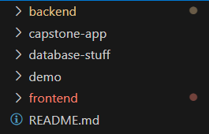
Code Architecture
Our code architecture is currently set up like this, a folder for frontend work and backend work. The other three folder were used for the testing of the database, the prototype front end, and the demo used for the fall section of this class.

Slide 10
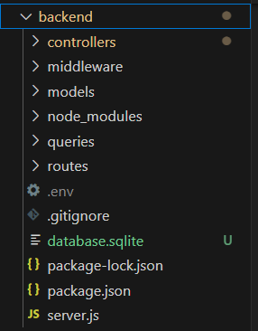
Code Architecture Cont
Furthermore our backend file is structured as the image shows. We have several folders showing the controllers, middleware, models, queries, and routes. We also included our env and gitignore file in this folder, as well as a database, and our server file.

Slide 11
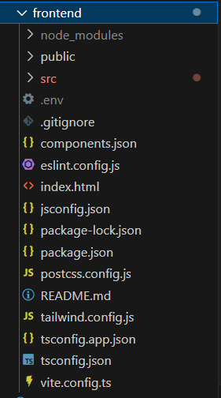
Code Architecture Cont
The frontend file is structured as the image shows. Several folders, including the src folder which includes a majority of the work. It holds the components, api fetch methods, index styling file, and several other things. This folder also includes its own env and git ignore file.

Slide 12
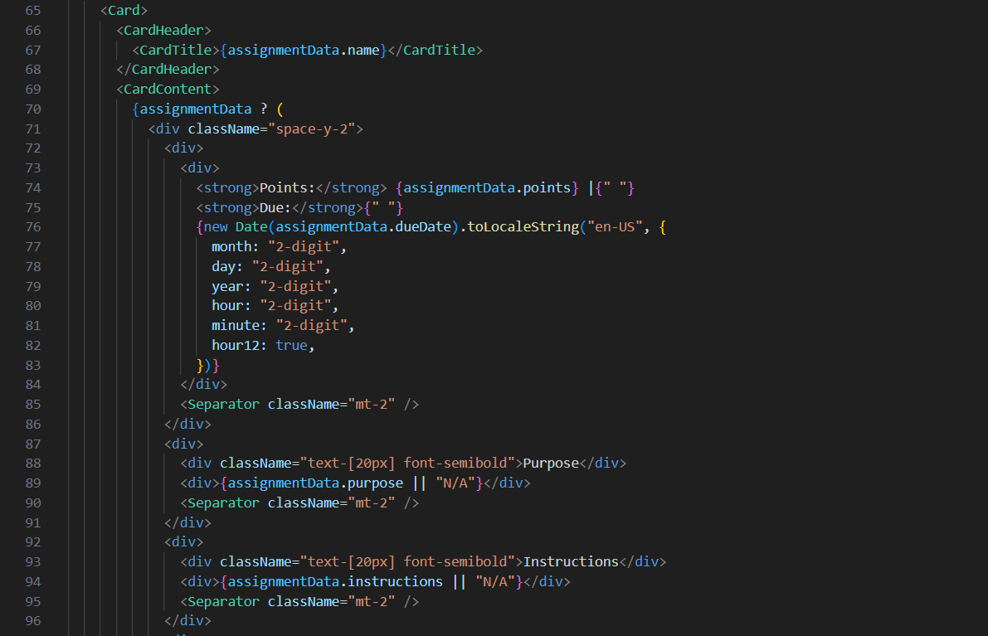
Codebase
Example JSX page (AssignmentPage.jsx)
Part of the code involved within a single jsx page.

Slide 13
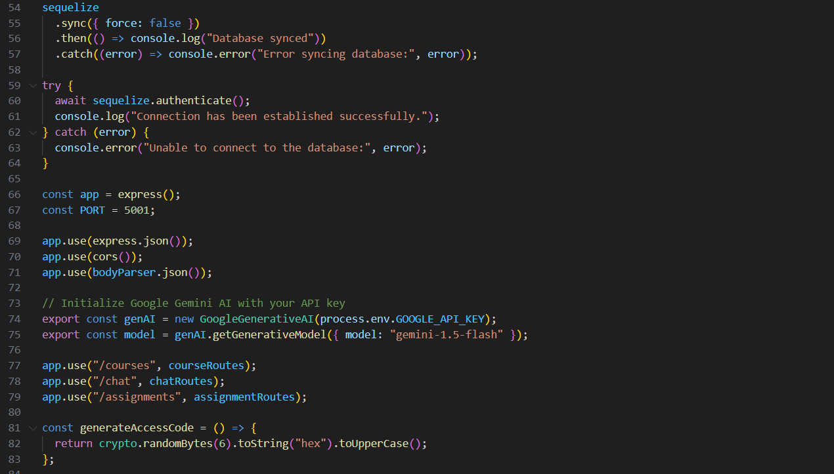
Codebase
Server.js
Handles creating the databases, starting the server, configuring the access codes.
A small portion of the code from that file.

Slide 14
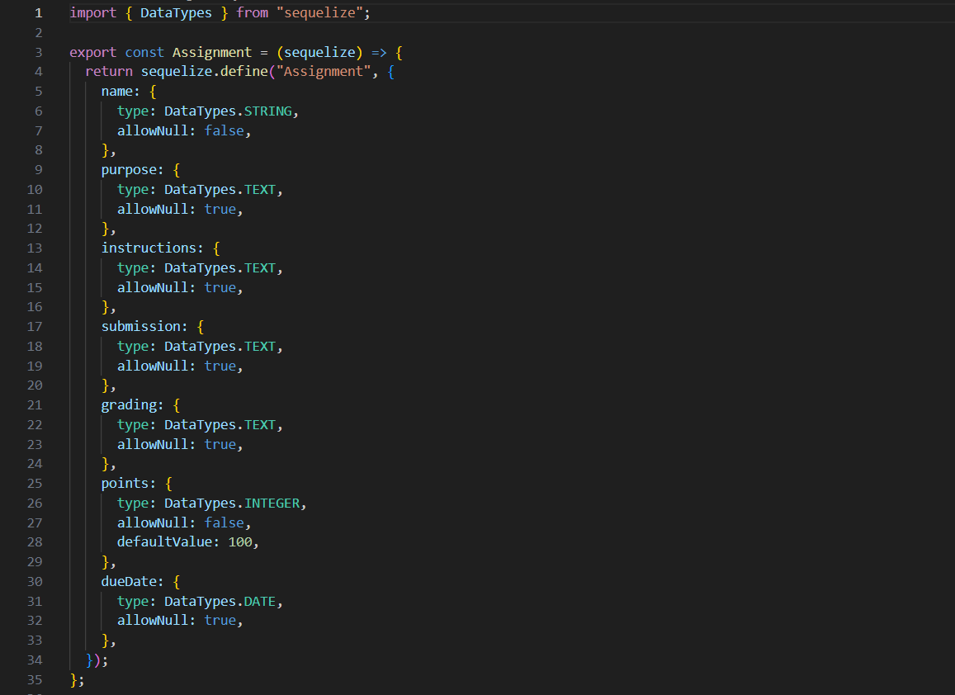
Codebase
Models (assignment.js)
This is a page for the assignment.js. It contains the various variables that a single assignment would hold and is used to create the table for the database.
There are several more models, with each one serving a different purpose.

Slide 15
Software Demo
(What parts we did individually)

Slide 16
Next Steps
Move our software to the OSU engineering servers rather than having to run it locally.
Deploy our software to real world scenarios, allowing students and teachers to test and give feedback.
Implementing additional quality of life features to our software, such as configurable chatbots and chatbot summaries of student interaction.

Slide 17
Conclusion
Feedback
We will continue to focus on implementing our project alongside our project mentor to make sure his concerns are addressed. We hope to address any bugs or other user issues that have been overlooked during the development process.
Results
Our software currently has the majority of the required functionality completed. However, several important secondary features still require implementation. These will be completed soon and we will plan to work further on new features after figuring out our migration to a server base from running it locally.

Slide 18
Feedback?

Slide 19
Thank You!

